Slide 1
Forces

Slide 2
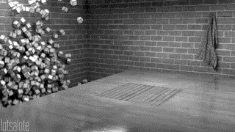
Welcome to this Smart Lesson on forces!
After completing this Smart Lesson you will be able to:
Describe the effect of forces on the motion of objects.
Perform calculations of force, mass, and acceleration.
Draw free body diagrams.
Describe support and tension forces.
Perform calculations of support and tension forces.

Slide 3
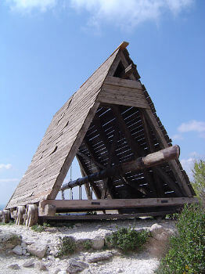
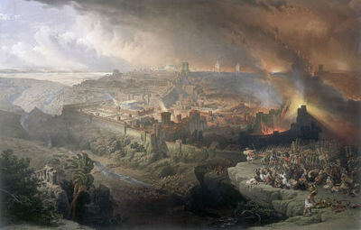
In this lesson we will be learning about forces in the context of battering rams.
Battering rams use a large amount of force to break open wooden gates and even stone walls.
Battering rams were used to great effect in the siege of Jerusalem in 70 CE, and in many other historic conflicts.

Slide 4
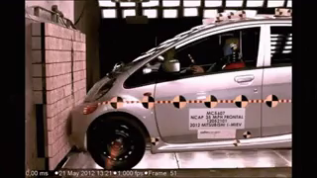
Forces
An object at rest will stay at rest unless acted on by a force. An object moving at constant velocity will continue to move in the same manner unless acted on by a force.
Whenever an object speeds up, slows down, starts, stops, or changes direction, it does so because of forces.

Slide 5
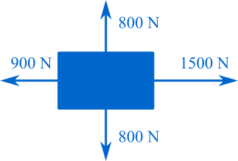
Objects can be affected by many forces at once.
The net force is the sum of all forces on an object, and it is the net force that causes objects to move.

Slide 6
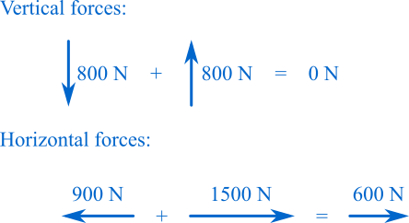

To calculate the net force on an object, sum the vertical and horizontal forces acting on the object.
Forces that point in the same direction are added together, and forces that point in opposite directions are subtracted from each other.
The sum of all forces acting on this object, and therefore the net force on this object is 600 N to the right.

Slide 7
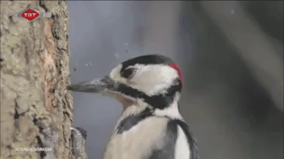
If the forces on an object cancel each other out they are balanced, and the object will stay at rest or keep moving with the same velocity.
If the forces on an object are unbalanced, the object will speed up, slow down, or change direction.

Slide 8
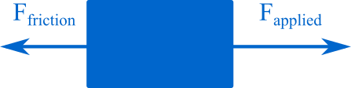
This is a free-body diagram. All of the forces on an object are drawn extending out from the object. These diagrams are useful for showing the size and direction of forces on an object.

Slide 9
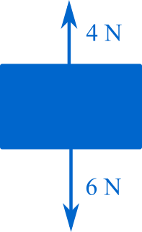
Example
This falling object is acted on by two forces: weight and air resistance.
Are the forces balanced? What is the net force?

Slide 10
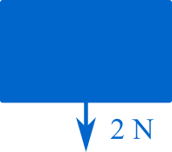
Solution
The weight and air resistance forces are not balanced as they have different magnitudes.
The net force is 2 N downward.

Slide 11
Example
Will the motion of the object below change over time?

Slide 12
Solution
The motion of the object will change over time as the forces are unbalanced.

Slide 13

Force and Acceleration
The greater the net force on an object, the faster the object accelerates.
The relationship between the acceleration of an object and the net force acting on the object can be described by this relationship:

Slide 14
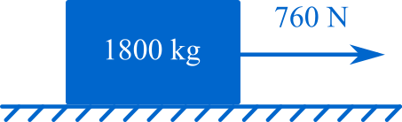
Example
This 1800 kg battering ram is being pushed with a net force of 760 N.
How fast does the battering ram accelerate?

Slide 15
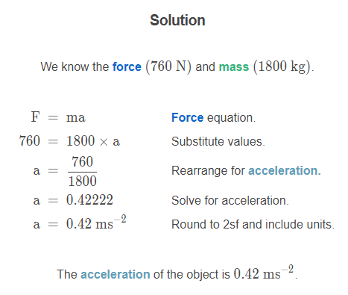

Slide 16
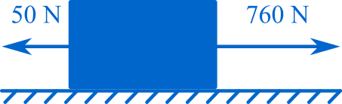
Example
The battering ram moves through some mud, which applies 50 N of friction to the ram, and slows its acceleration to 0.37 ms−2. The mud stuck to the ram increases its mass.
What is the mass of the battering ram with mud stuck to it?

Slide 17
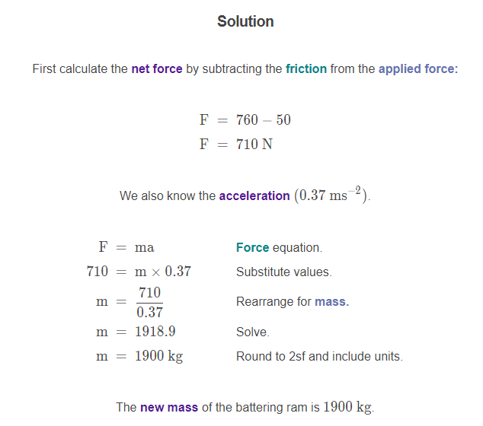

Slide 18
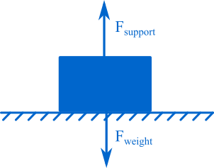
Support Force
Whenever a force is applied, an equal and opposite force is also applied.
Forces come in pairs.
An object sitting on the ground isn't moving, so the forces on it must be balanced. Gravity pulls the object against the ground, and the support force pushes back.

Slide 19
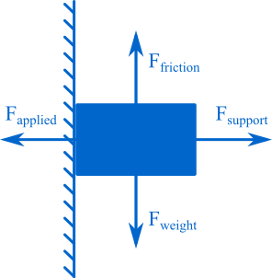
This object is pressed against a wall by an applied force. The support force presses directly out from the wall to oppose the applied force.
The support force is equal and opposite to the force pushing into the surface (assuming the wall doesn't collapse).
The object is also affected by gravity. Friction with the wall opposes the force of gravity and keeps the object at rest.

Slide 20
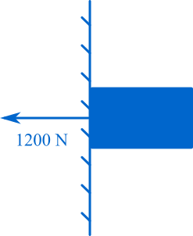
Example
This object is pressed against a wall with an applied force of 1200 N. What is the size and direction of the support force applied by the wall?

Slide 21
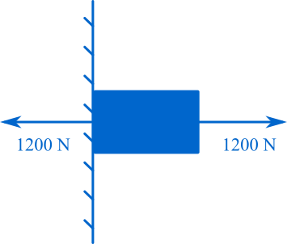
Solution
The support force is equal and opposite to the applied force.
The support force is 1200 N to the right.

Slide 22
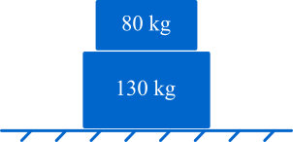
Example
What are the support forces on the 80 kg and 130 kg masses?

Slide 23
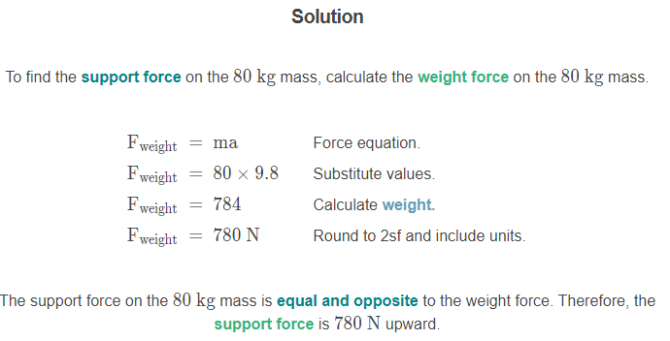

Slide 24
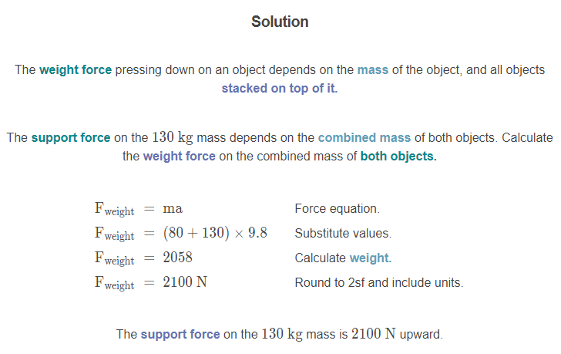

Slide 25
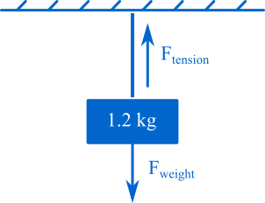
Tension
This hanging object isn't moving, so the forces on it must be balanced. Gravity pulls the object toward the ground, and a tension force pulls back.
The tension force is equal and opposite to the weight force.

Slide 26
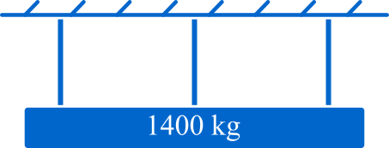
Example
This battering ram is hung from its frame by three ropes with equal tension. What is the tension force in each rope?

Slide 27
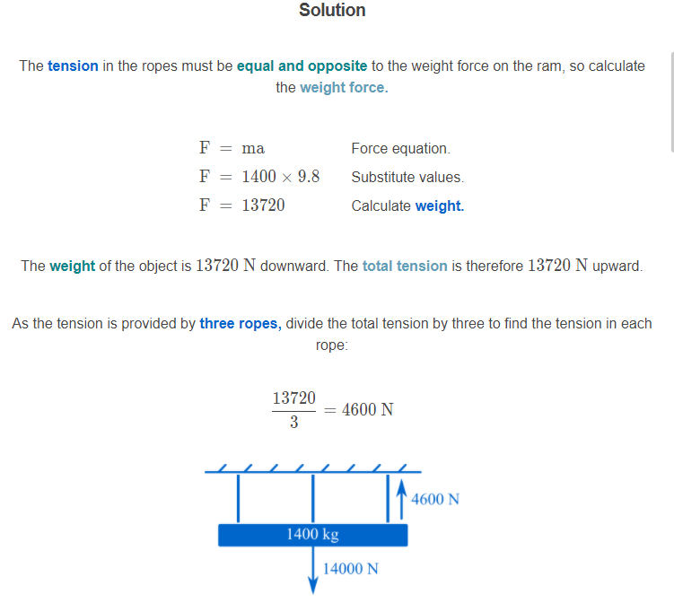

Slide 28
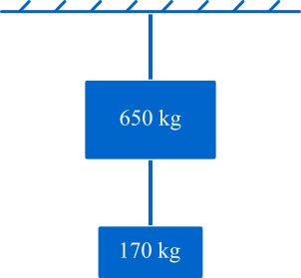
Example
How much tension is there in the top and bottom ropes?

Slide 29
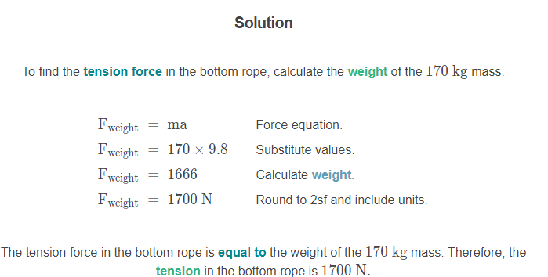

Slide 30
